Slide 1


Slide 2


Slide 3


Slide 4


Slide 5


Slide 6


Slide 7


Slide 8
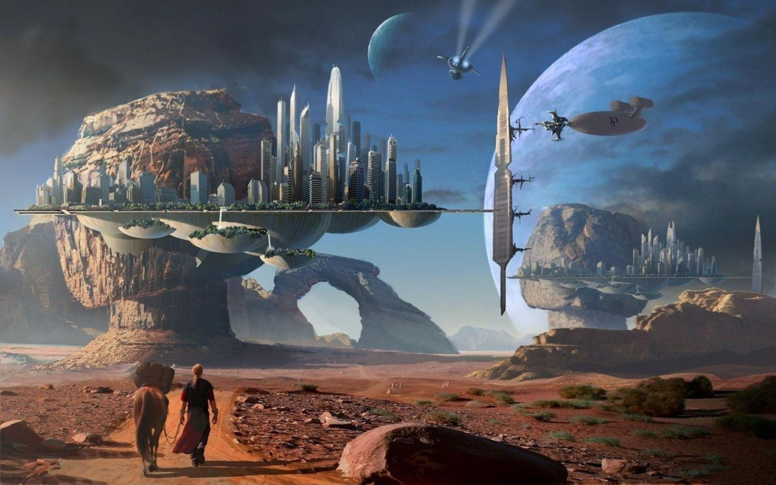

Slide 9
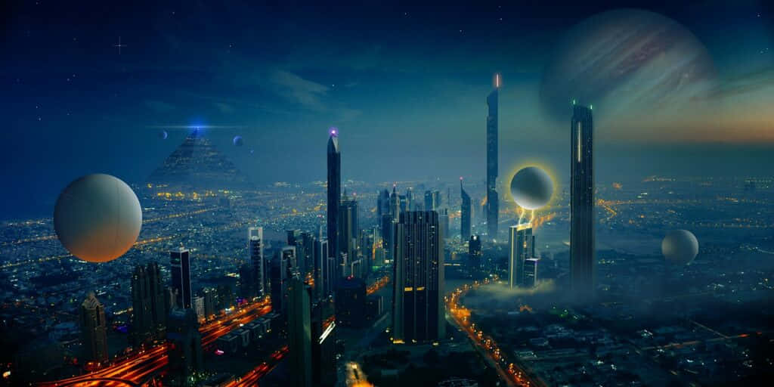

Slide 10


Slide 11


Slide 12
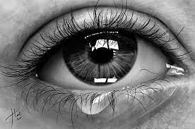
Dear
From

Slide 13
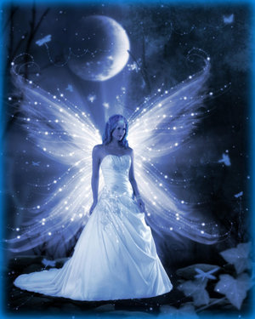
Dear
From

Slide 14

Dear
From

Slide 15

Dear
From

Slide 16
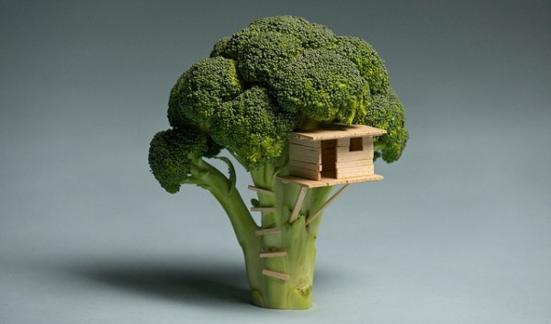
Dear
From

Slide 17
Dear
From

Slide 18

Dear
From

Slide 19

Dear
From

Slide 20

Dear
From

Slide 21
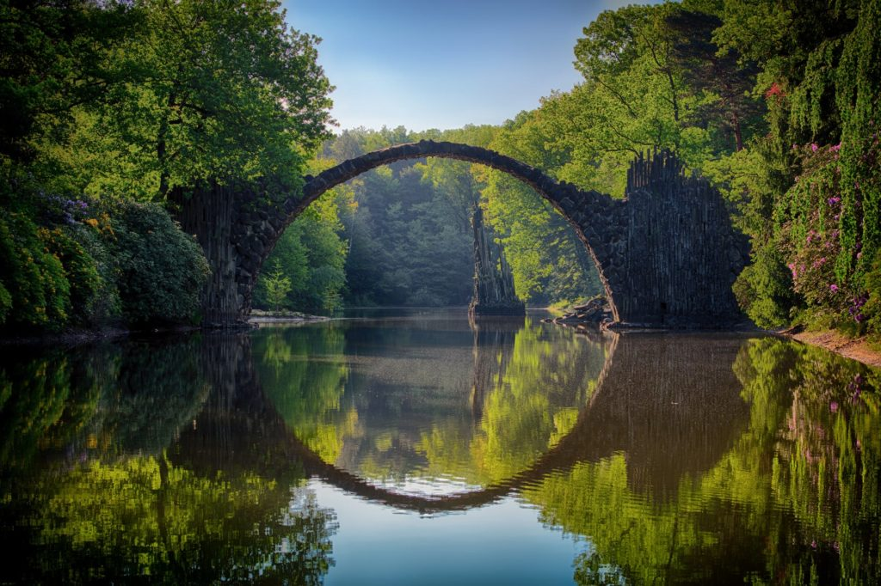
Dear
From

Slide 22

Dear
From

Slide 23

Dear
From

Slide 24

Dear
From

Slide 25

Dear
From

Slide 26

Dear
From

Slide 27

Dear
From

Slide 28

Dear
From

Slide 29

Dear
From

Slide 30
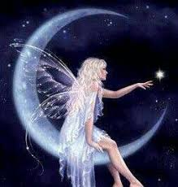
Dear
From

Slide 31

Dear
From

Slide 32

Dear
From

Slide 33
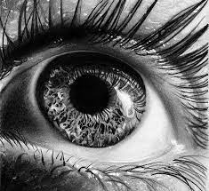
Dear
From

Slide 34
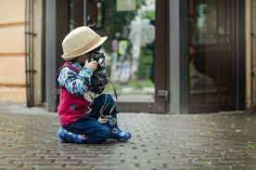

Dear
Dear
From
From

Slide 35

Dear
From

Slide 36

Dear
From

Slide 37

Dear
From

Slide 38


Dear
Dear
From
From

Slide 39
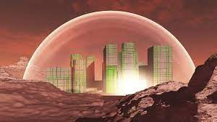

Dear
Dear
From
From

Slide 40

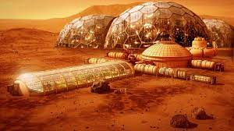
Dear
Dear
From
From

Slide 41


Dear
Dear
From
From

Slide 42

Dear
From

Slide 43

Dear
From

Slide 44


Dear
Dear
From
From

Slide 45


Dear
Dear
From
From

Slide 46


Dear
Dear
From
From

Slide 47

Dear
From

Slide 48


Dear
Dear
From
From

Slide 49

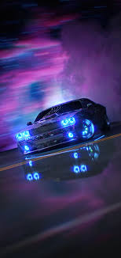
Dear
Dear
From
From

Slide 50


Dear
Dear
From
From

Slide 51


Dear
Dear
From
From

Slide 52


Dear
Dear
From
From

Slide 53



Dear
Dear
Dear
From
From
From

Slide 54

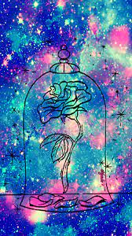

Dear
Dear
Dear
From
From
From

Slide 55



Dear
Dear
Dear
From
From
From

Slide 56


Dear
Dear
From
From

Slide 57


Dear
Dear
From
From

Slide 58


Dear
Dear
From
From

Slide 59

Dear
From

Slide 60

Dear
From

Slide 61

Dear
From

Slide 62

Dear
From

Slide 63

Dear
From

Slide 64

Dear
From

Slide 65

Dear
From

Slide 66

Dear
From

Slide 67

Dear
From

Slide 68

Dear
From

Slide 69

Dear
From

Slide 70


Dear
Dear
From
From

Slide 71

Dear
From

Slide 72

Dear
From

Slide 73

Dear
From

Slide 74
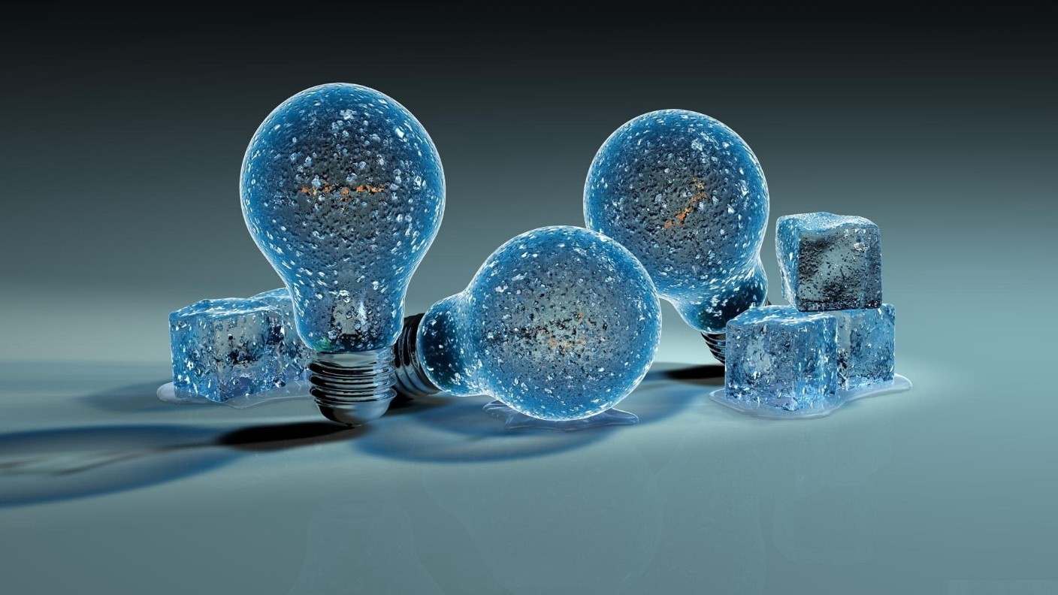
Dear
From

Slide 75
Dear
From

Slide 76

Dear
From

Slide 77

Dear
From

Slide 78


Dear
Dear
From
From

Slide 79
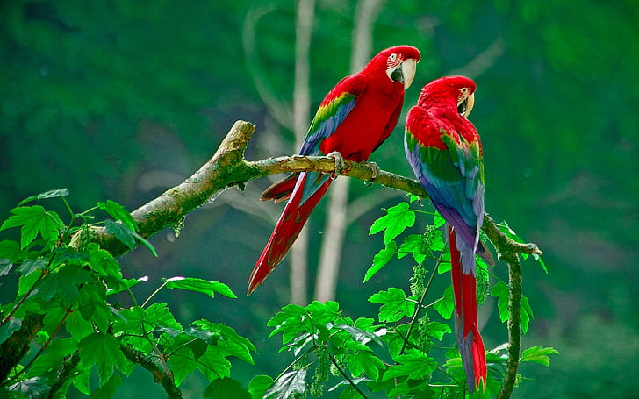
Dear
From

Slide 80
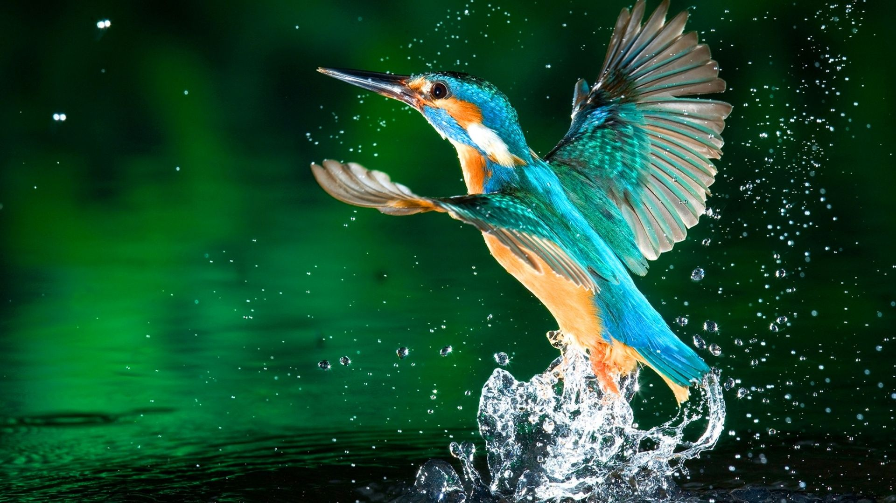
Dear
From

Slide 81

Dear
From

Slide 82
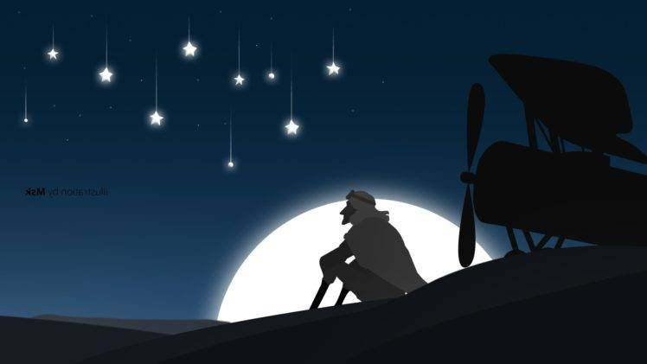
Dear
From

Slide 83

Dear
From

Slide 84


Dear
Dear
From
From

Slide 85

Dear
His
Her
From

Slide 86

Dear
From

Slide 87
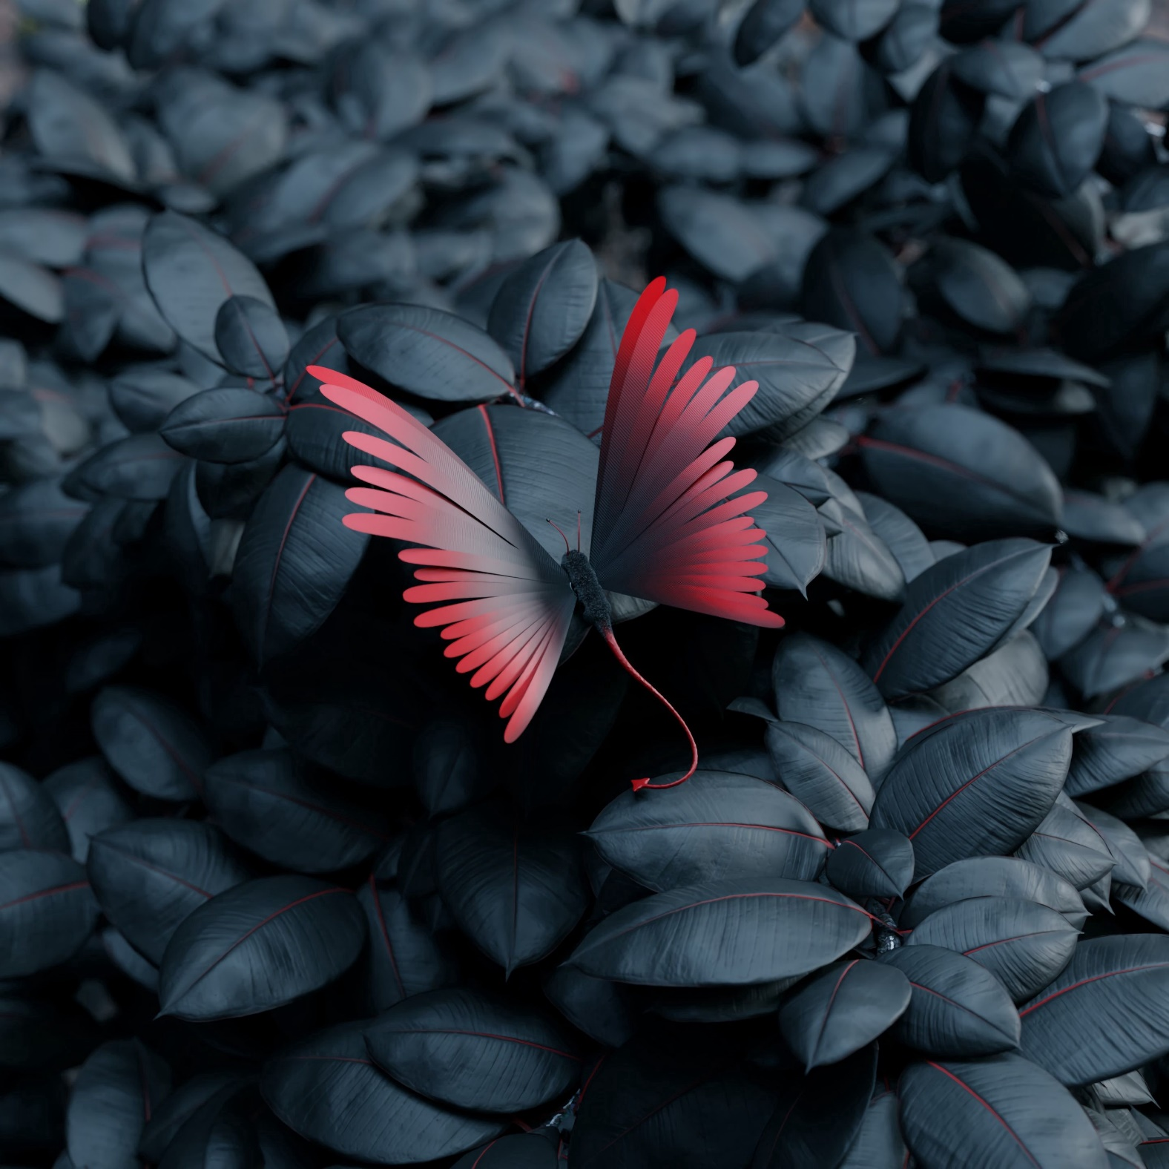

Dear
Dear
From
From

Slide 88

Dear
From

Slide 89

Dear
From

Slide 90

Dear
From

Slide 91

Dear
From

Slide 92

Dear
From

Slide 93

Dear
From

Slide 115

Dear
From

Slide 116

Dear
From

Slide 117

Dear
From

Slide 118


Dear
Dear
From
From

Slide 119

Dear
From

Slide 120

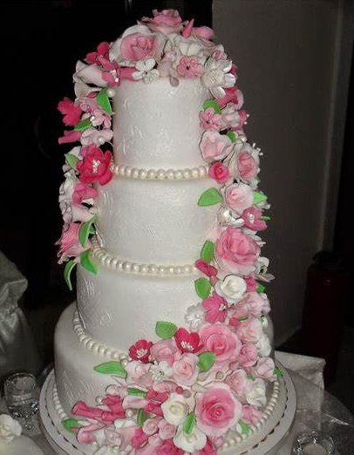
Dear
Dear
From
From

Slide 121


Dear
Dear
From
From

Slide 122
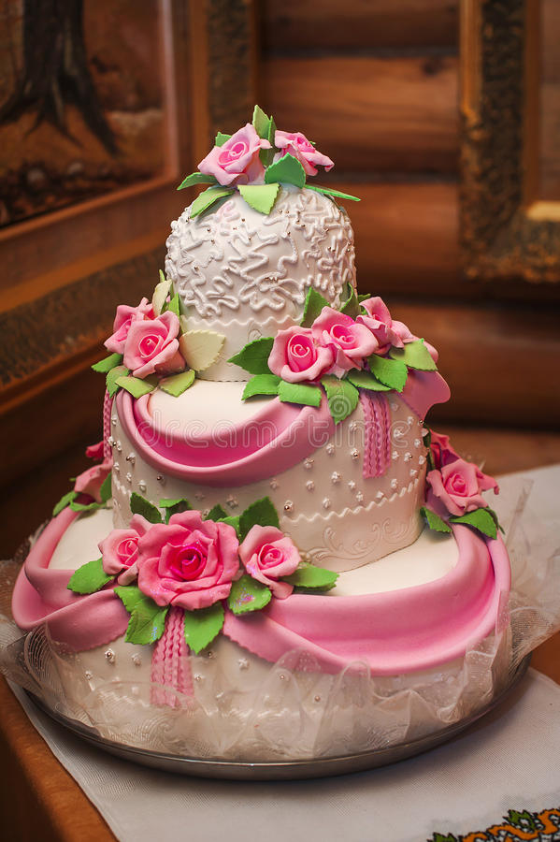
Dear
From

Slide 123
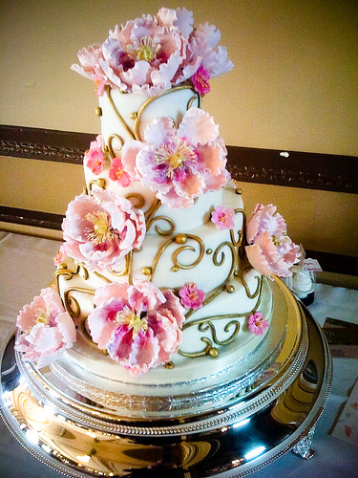
Dear
From

Slide 124
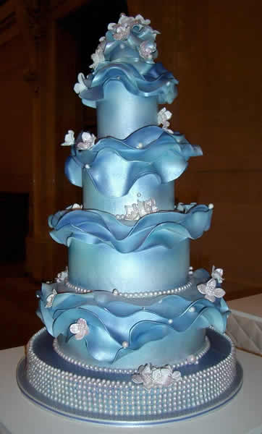
Dear
From

Slide 125

Dear
From

Slide 126

Dear
From

Slide 127

Dear
From

Slide 128

Dear
From

Slide 129
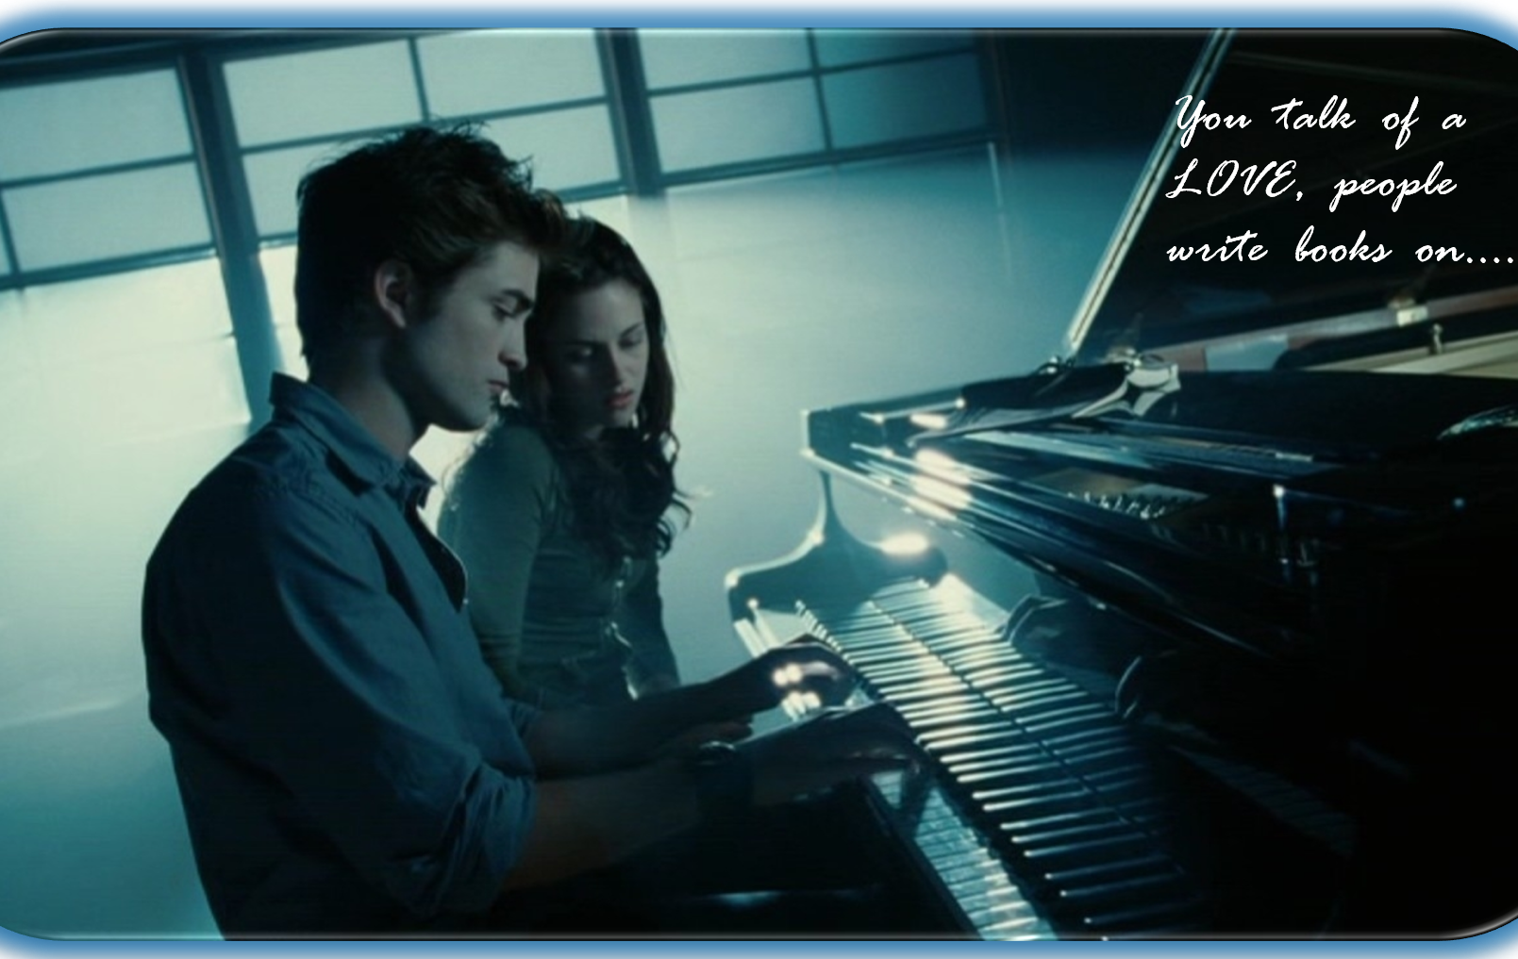
Dear
From

Slide 130

Dear
From

Slide 131

Dear
From

Slide 132

Dear
From

Slide 133
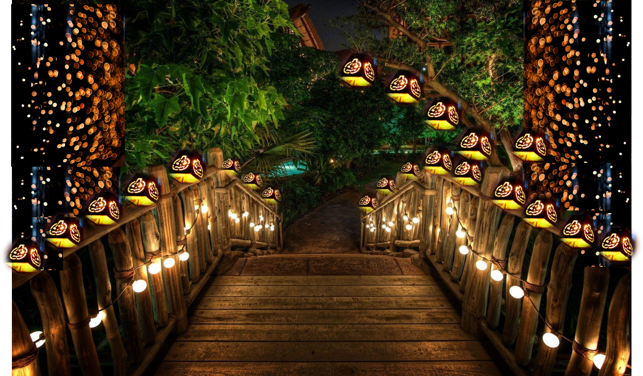
Dear
From

Slide 134

Dear
From

Slide 135
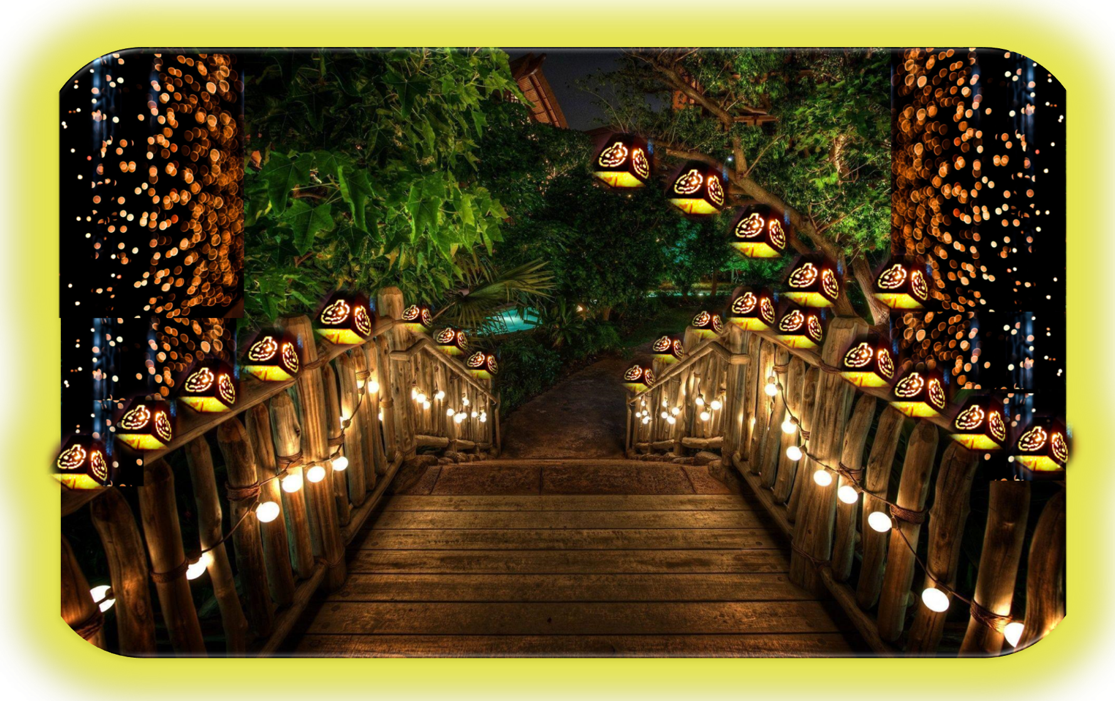
Dear
From

Slide 136

Dear
From

Slide 137

Dear
From

Slide 138
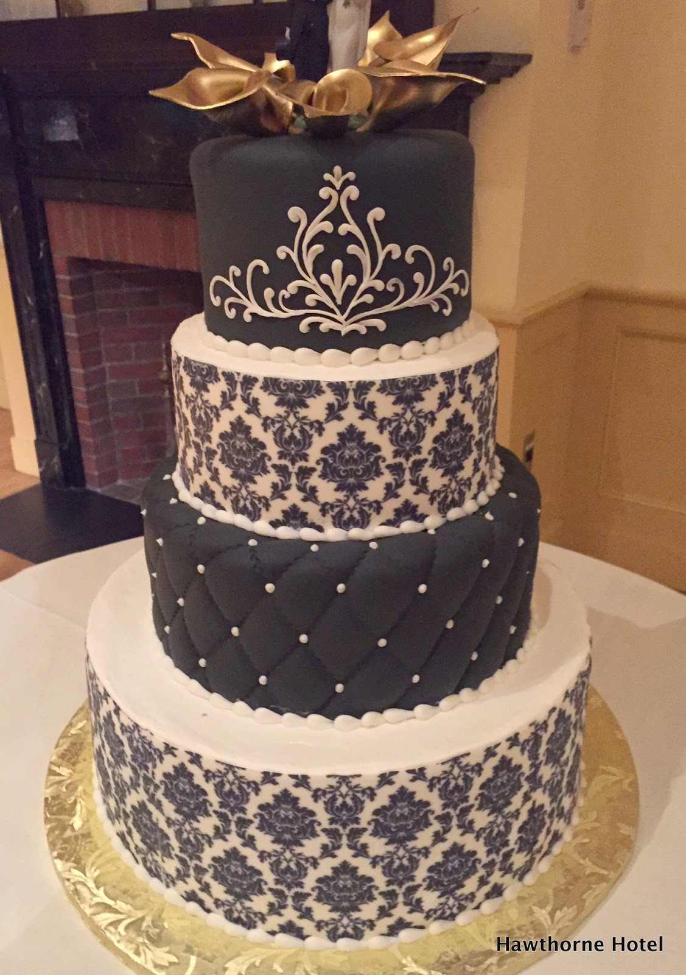
Dear
From

Slide 139

Dear
From

Slide 140

Dear
From

Slide 141

Dear
From

Slide 142

Dear
From

Slide 143

Dear
From

Slide 144

Dear
From

Slide 145

Dear
From

Slide 146
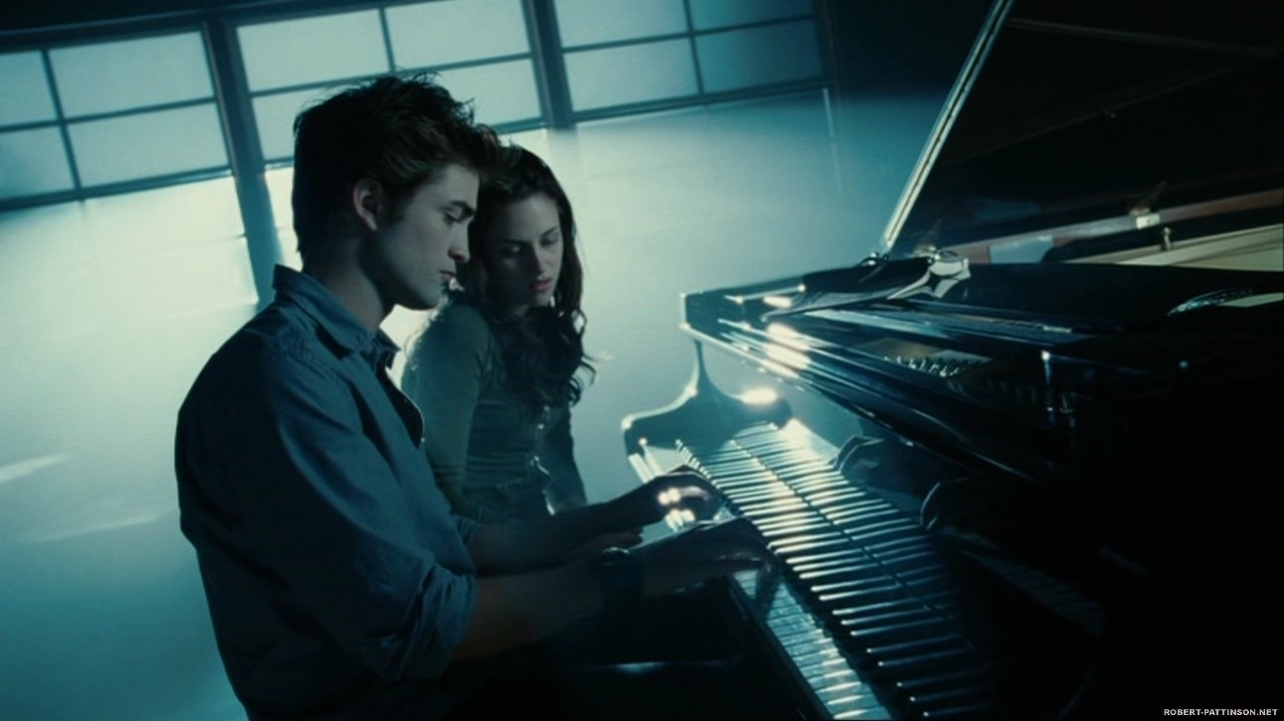
Dear
From

Slide 147

Dear
From

Slide 148

Dear
From

Slide 149
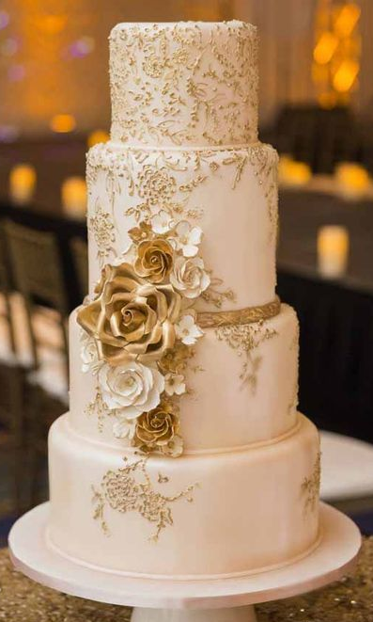
Dear
From

Slide 150

Dear
From

Slide 151

Dear
From

Slide 152
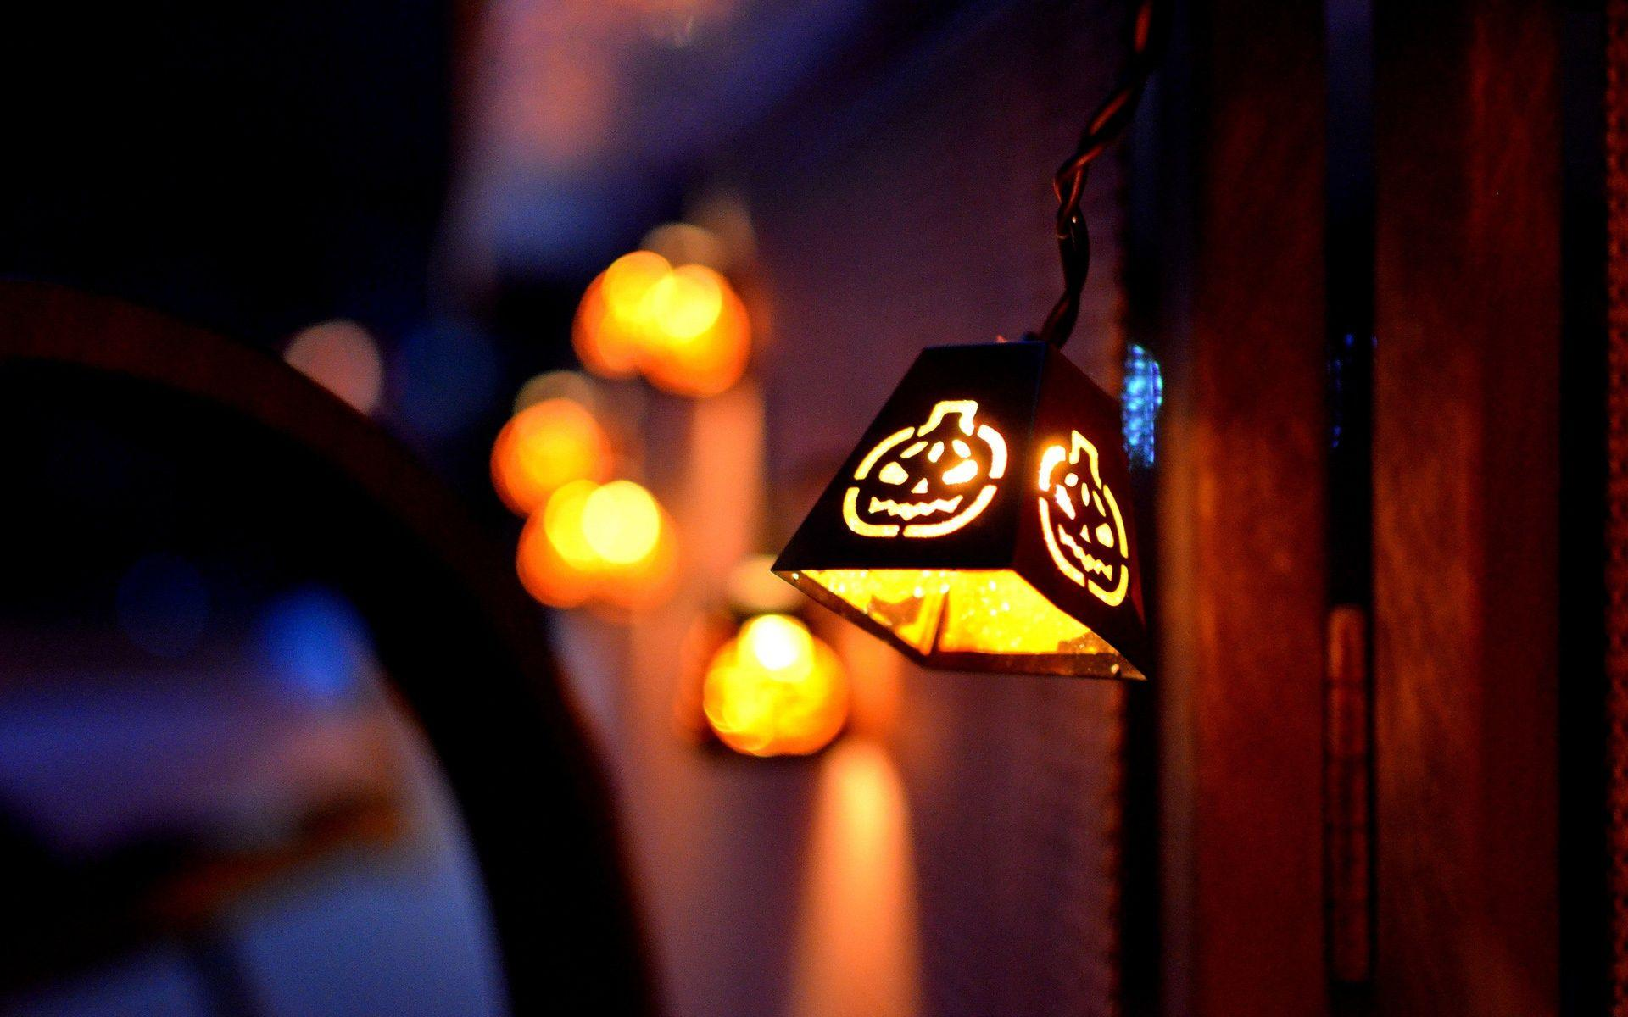
Dear
From

Slide 153

Dear
From

Slide 154
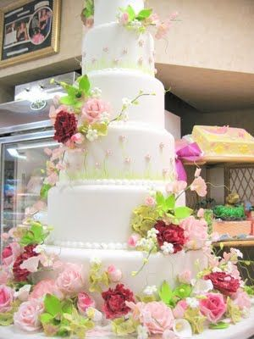
Dear
From

Slide 155

Dear
From

Slide 156

Dear
From

Slide 157

Dear
From

Slide 158
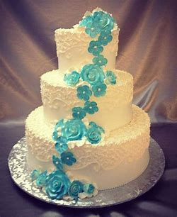
Dear
From

Slide 159
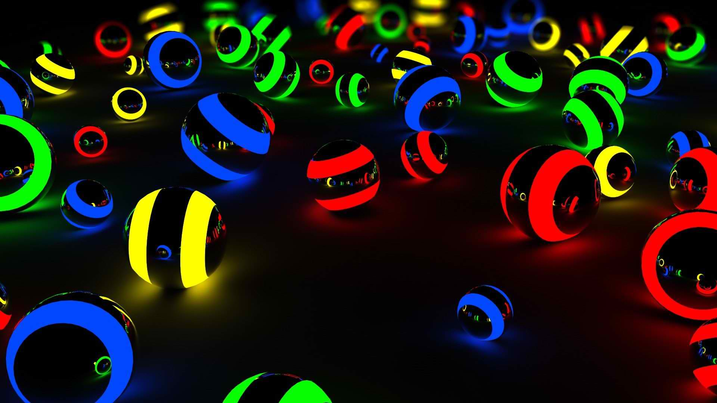
Dear
From

Slide 160

Dear
From

Slide 161

Dear
From

Slide 162

Dear
From

Slide 163

Dear
From

Slide 164

Dear
From

Slide 165
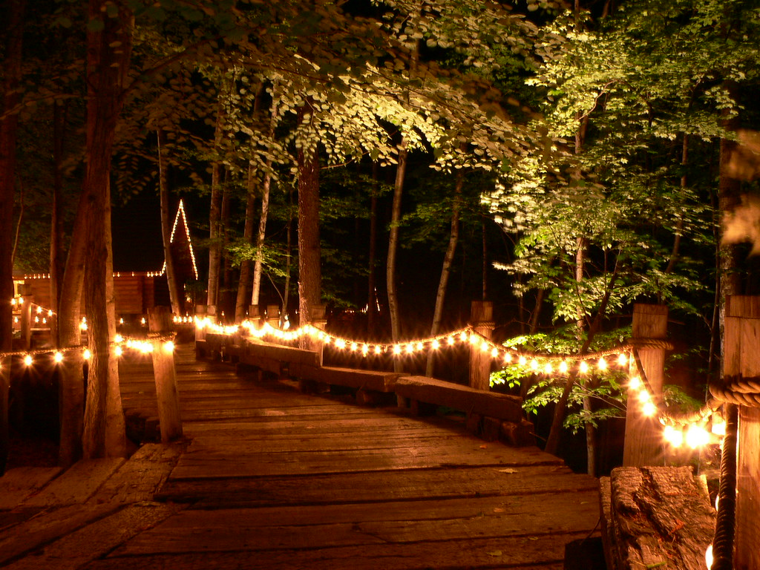
Dear
From

Slide 166

Dear
From

Slide 167

DEAR
From

Slide 168

Dear
From

Slide 169

Dear
From

Slide 170

Dear
From

Slide 171

Dear
From

Slide 172
Dear
From

Slide 173

Dear
From

Slide 174

Dear
From

Slide 175
Dear
From

Slide 176


Dear
From

Slide 177

Dear
From

Slide 178
Dear
From

Slide 179

Dear
From

Slide 180

Dear
From

Slide 181
Dear
From

Slide 182

Dear
From

Slide 183

Dear
From

Slide 184
Dear
From

Slide 185

Dear
From

